Slide 1
Mbuild in WebGME
Status Report
Ruobing, Hengqing and Tengyu

Slide 2
MBuild – Composite Hierarchy Modeling
mBuild does hierarchical modeling, using the Composite pattern.
The leaves of the hierarchy are particles (atoms).
Atoms can be composed into Molecule.
Molecules can then be composed into Copolymer or Polymer.
and Copolymers finally make up the more complex components.
In mBuild, Ports define the geometric constraints of the composition.
Anchor connects atoms with ports
Bond connects atoms and atoms
After provide the precise representation of composites:
Visualizing the composites and trying to generate out the resulting molecular systems

Slide 3
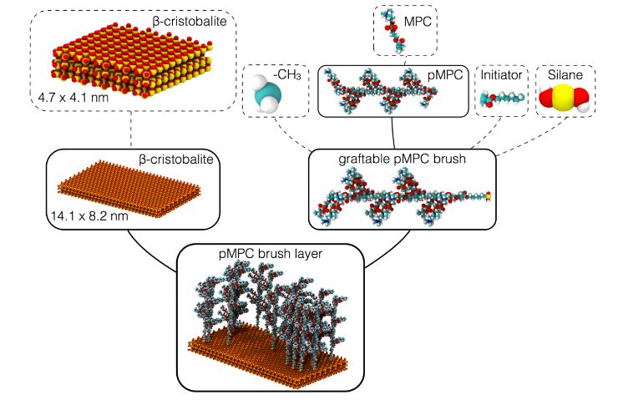
Background
We will come up with a GME DSML project for mBuild.

Slide 4
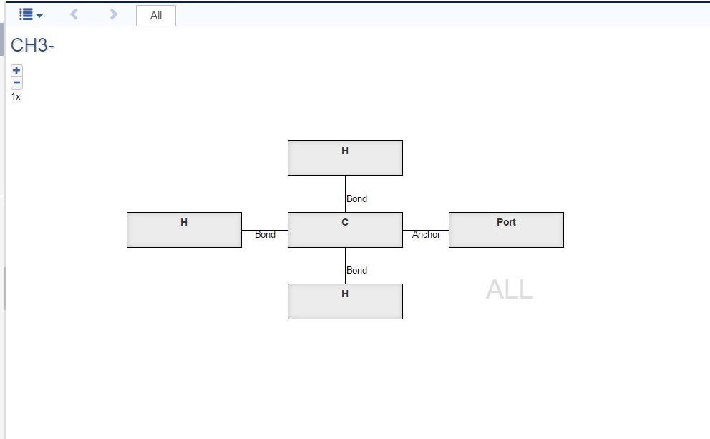
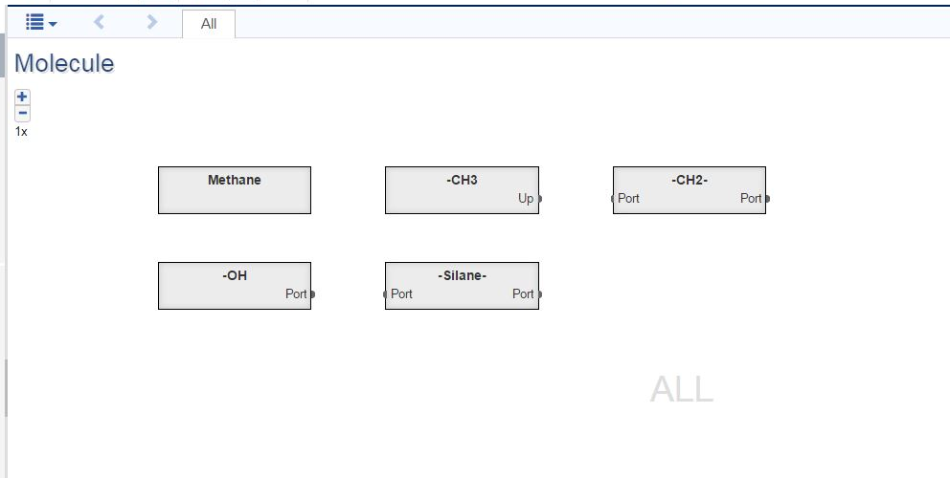
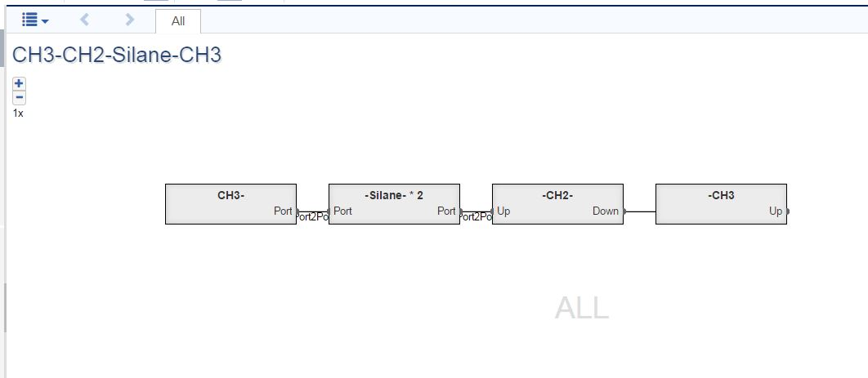
Demonstration of Hierarchy

Slide 5
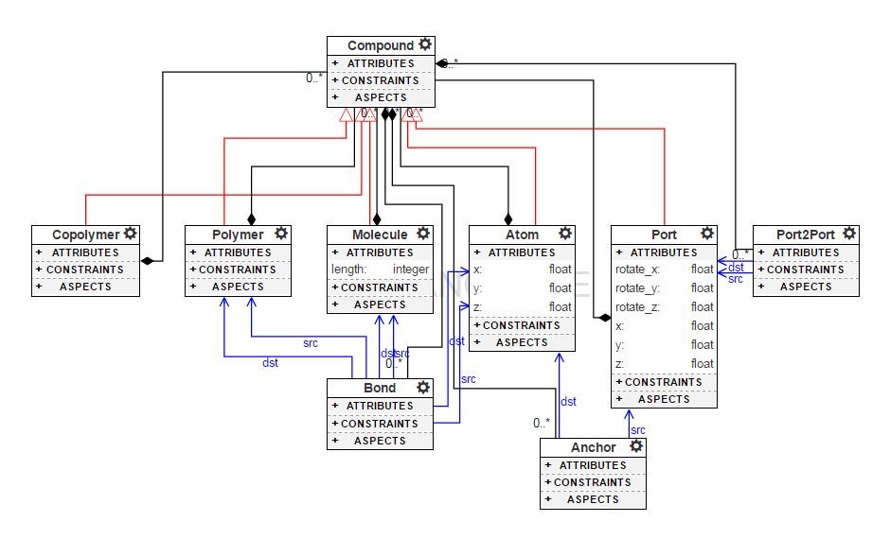
Metalmodel
The hierarchy structure of Metalmodel for Mbuild

Slide 6
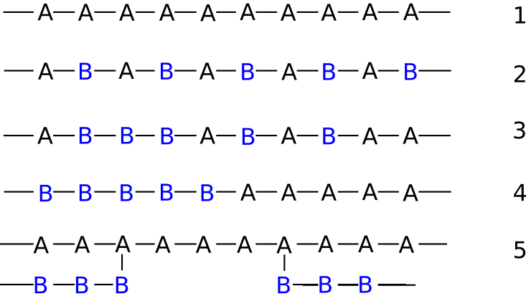
Matters needing attention
What’s the differences between Copolymer and Polymer?
Alternating copolymers (Polymer)
Periodic copolymers: A & B units arranged in a repeating sequence
Statistical/Random copolymers: no set rule about A/B’s position in chain
Block copolymers: comprise two or more homopolymer subunits

Slide 7

Matters needing attention
What’s the differences between Copolymer and Polymer?
Alternating copolymers (Polymer) e.g. CH3-CH2*n-CH3
Copolymer e.g. CH3-CH2-Silane-CH3

Slide 8
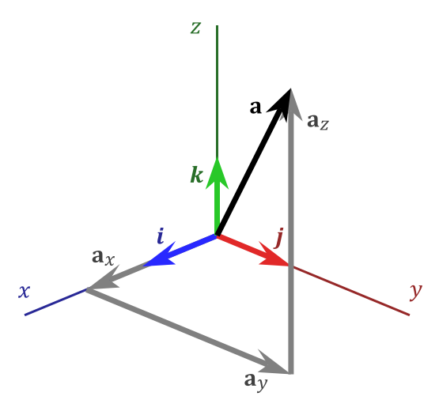
Matters needing attention
What’s the meaning of attributes of Atom?
Have three attributes: (x, y, z)
Determine its coordinates in space
What’s the meaning of attributes of Port?
Have six attributes: (x, y, z) & (rotate_x, rotate_y, rotate_z)
The angle between the atom’s ports are fixed (geometric constraints).

Slide 9
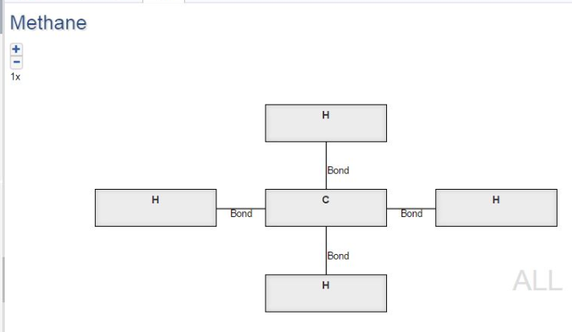
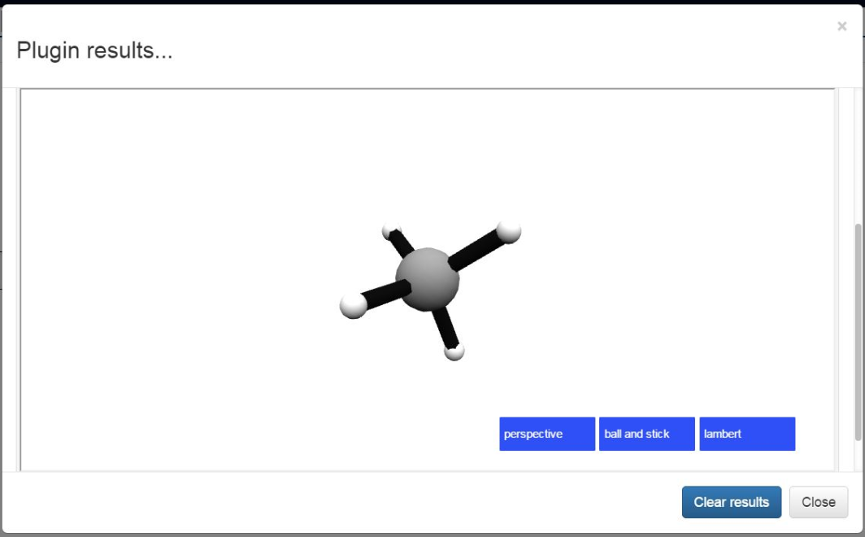
Implementation Details

Slide 10
Implementation Details
JavaScript
JSON
Python
HTML
JavaScript

Slide 11
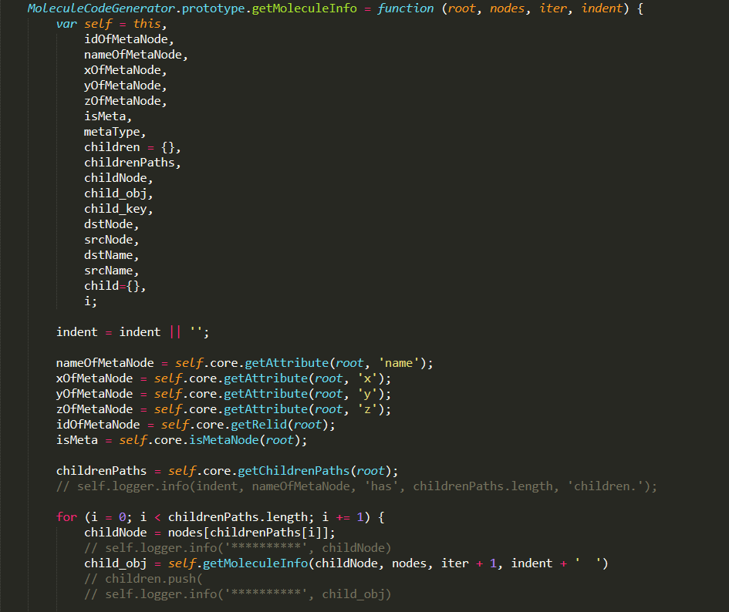
Generate JSON File

Slide 12
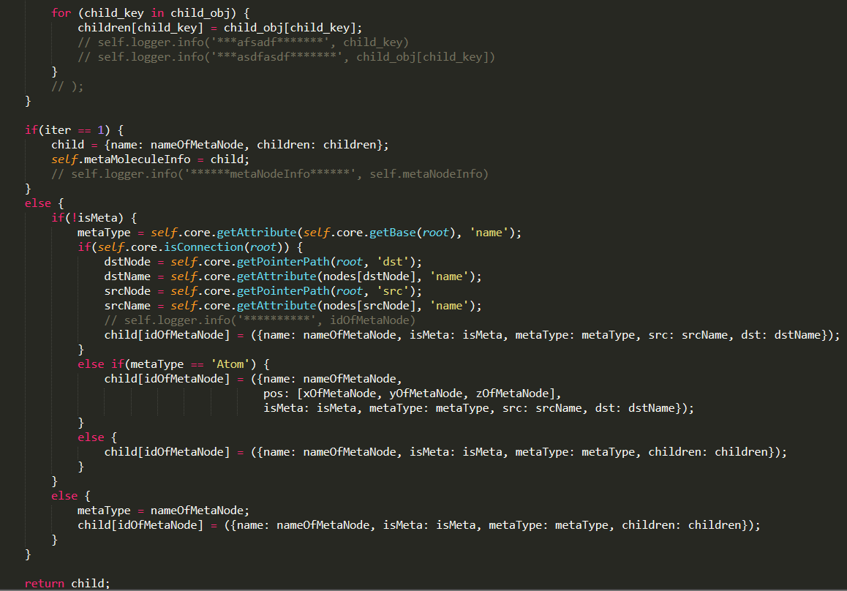
Generate JSON File

Slide 13
Find what we want
JavaScript
Generate EntireTree
Return WhatWeWant
JSON

Slide 14
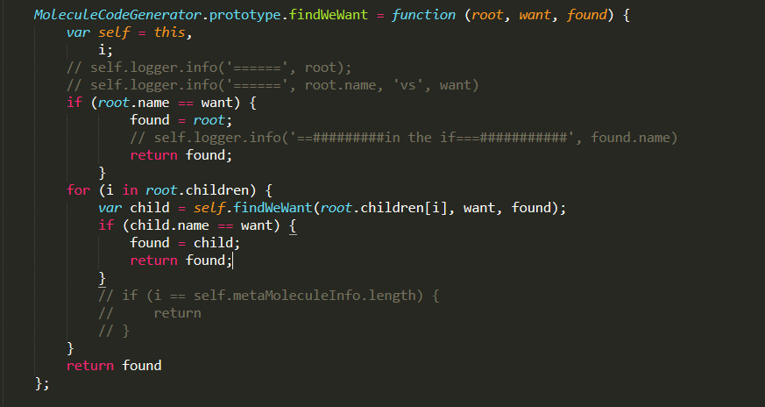
Find what we want

Slide 15
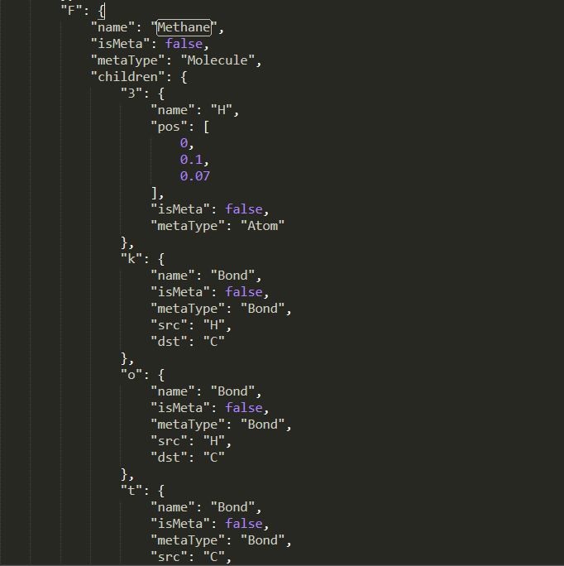
JSON Data : Methane

Slide 16
ejs part
JSON
ejs template
Python

Slide 17
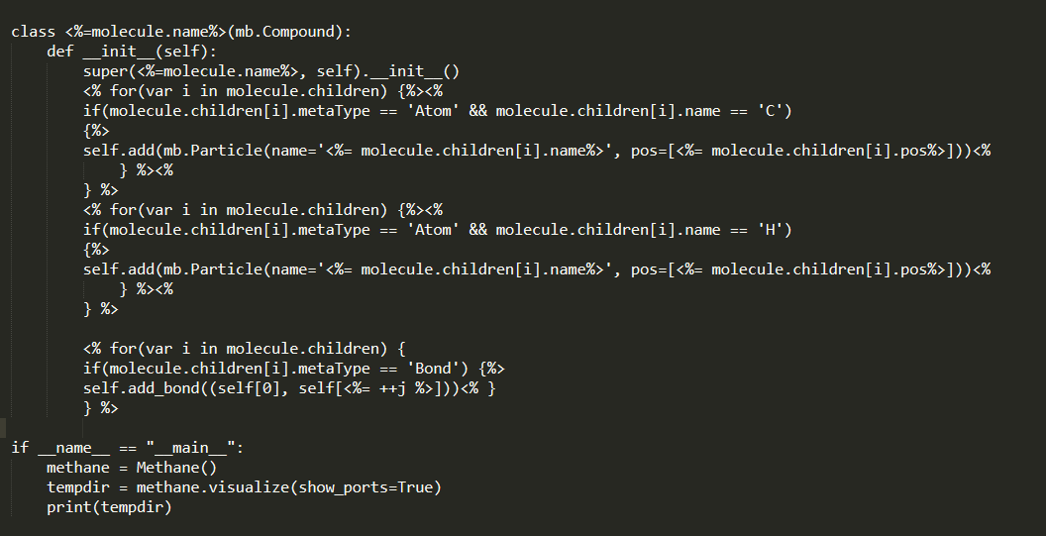
ejs part

Slide 18
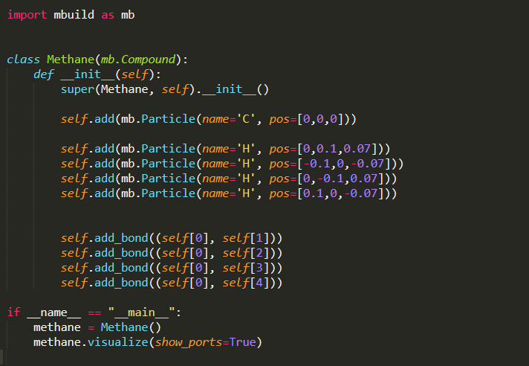
Generated Python File

Slide 19
Final Step
Python
HTML

Slide 20
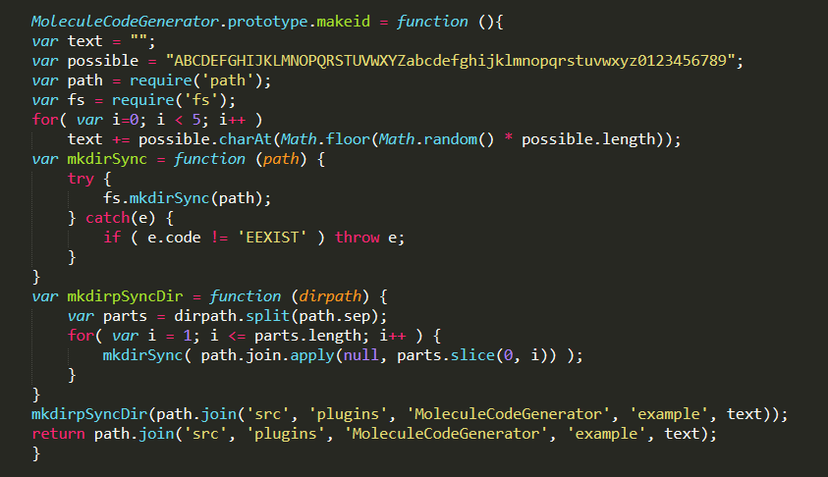
Final Step

Slide 21
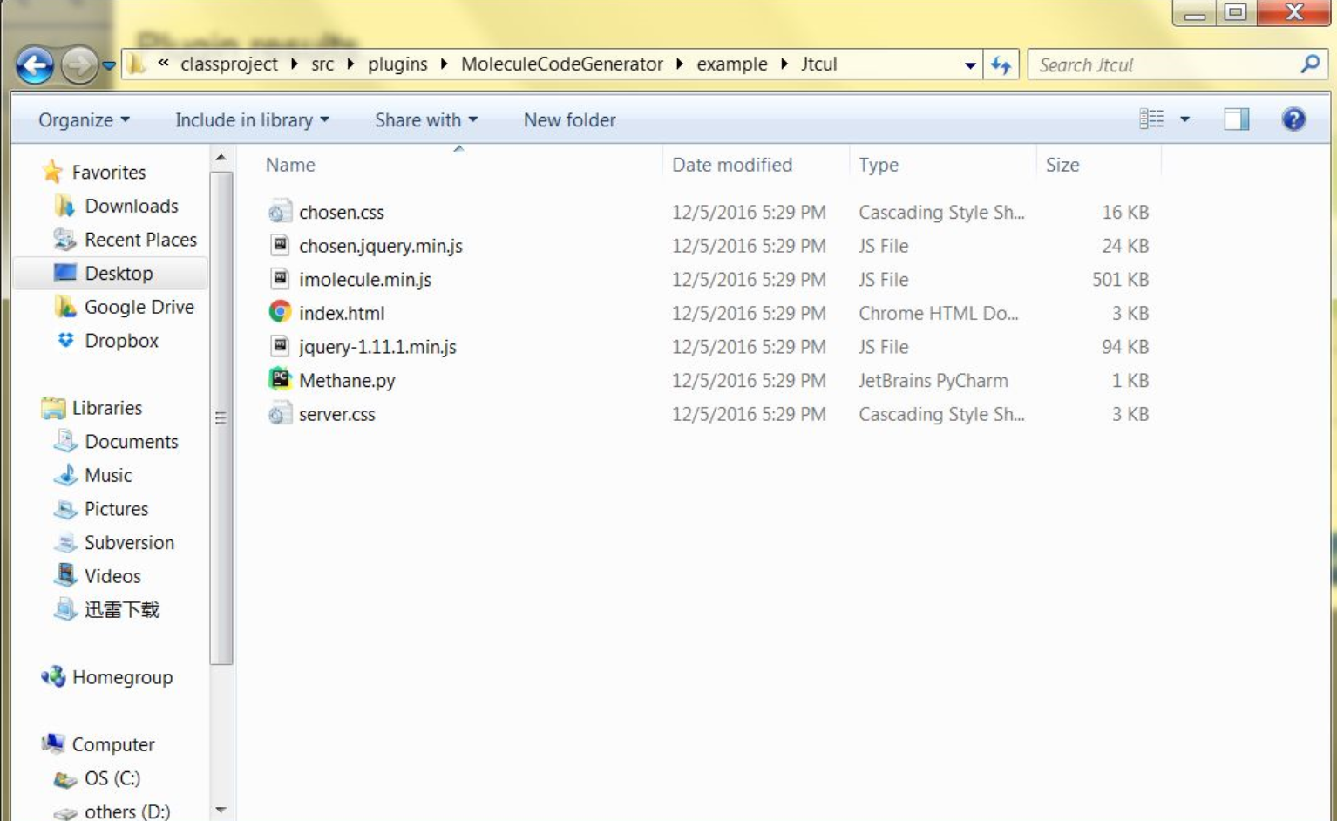
Final Step

Slide 22
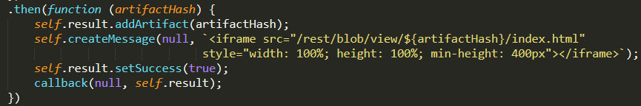
Final Step
HTML
JavaScript
Result

Slide 23
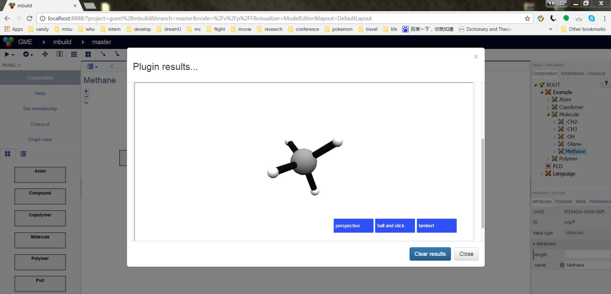
Result

Slide 24
Demo Time !

Slide 25
Thank you

